Slide 1

Introduction to GenAI and RAG – Manufacturing use cases
– Arish P

Slide 2
Prerequisites…
Generative AI
Large Language Models
Tokenization & Word Embeddings
After prerequisites… RAG

Slide 3
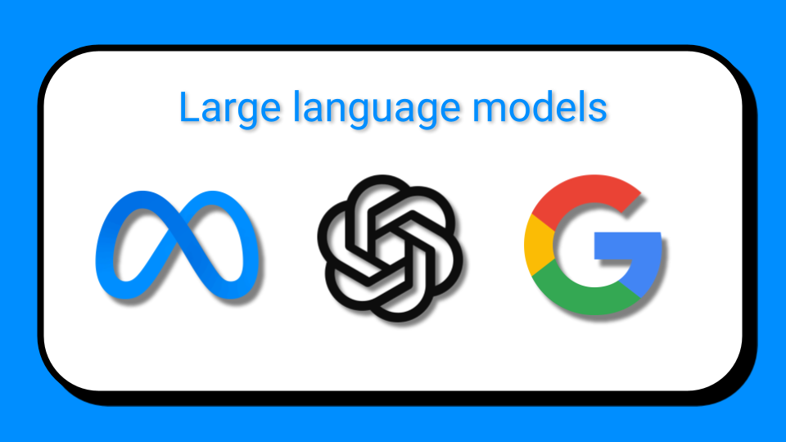
Generative AI
OpenAI GPT
Google Gemini
Meta Llama

Slide 4
Generative AI
Generative AI model generates new data based on training sample. It can generate Image,Text, Audio, Videos etc. data as output.

Slide 5
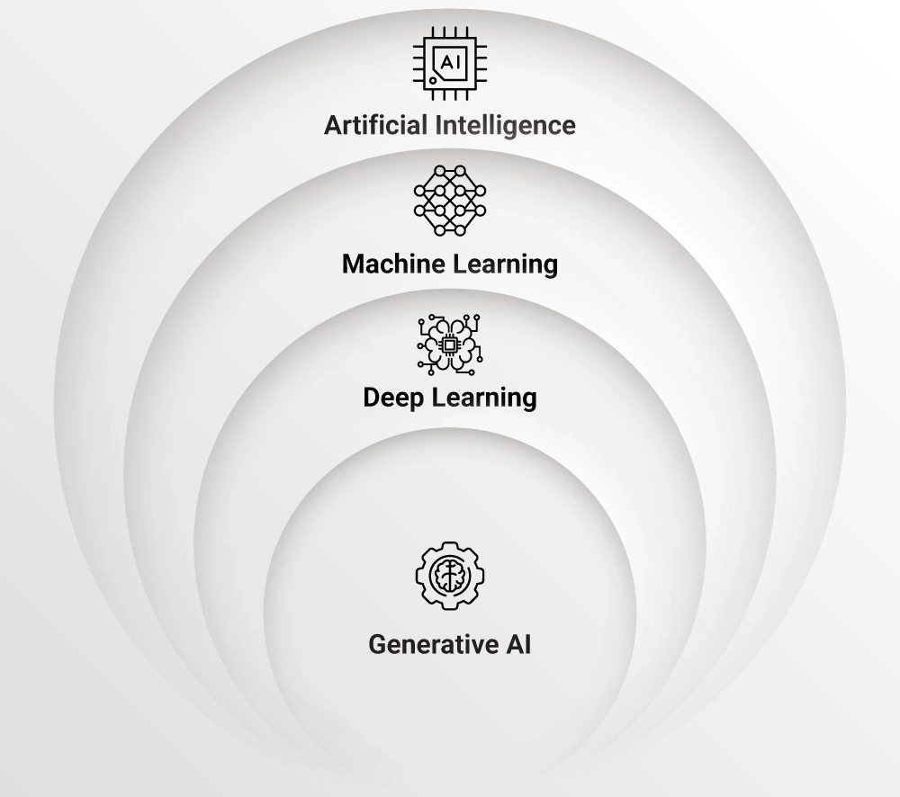
Where does it sit?

Slide 6

Deep Learning Tools
Artificial Neural Network (ANN)

Slide 7
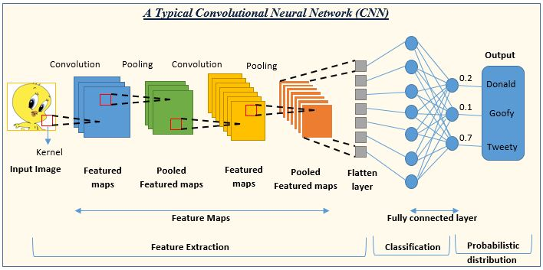
Deep Learning Tools
Convolutional Neural Network (CNN)

Slide 8
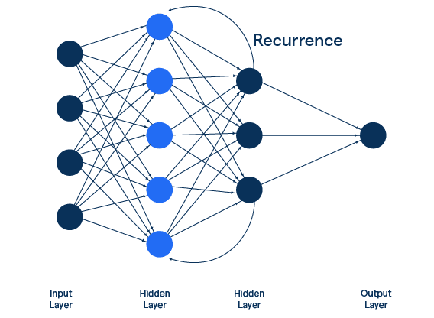
Deep Learning Tools
Recurrent Neural Network (RNN)

Slide 9
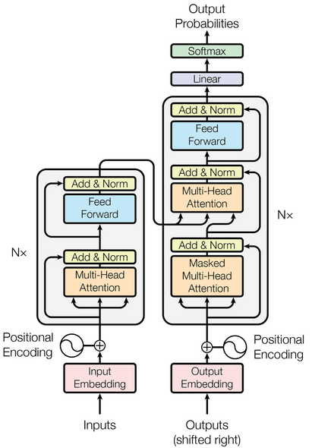
Deep Learning Tools
Transformers

Slide 10
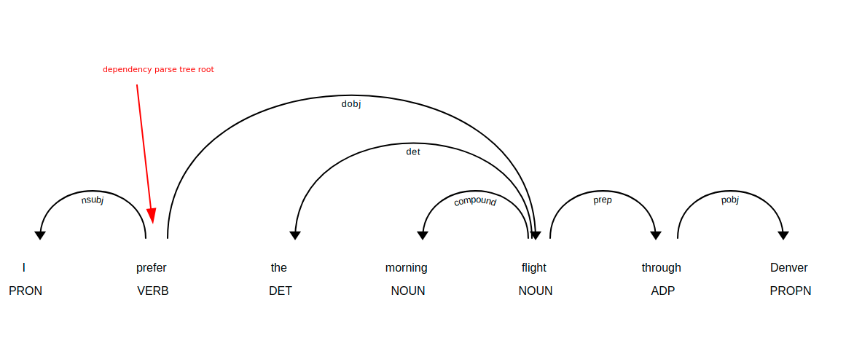
Deep Learning Tools
Transformers - Attention is all you need

Slide 11
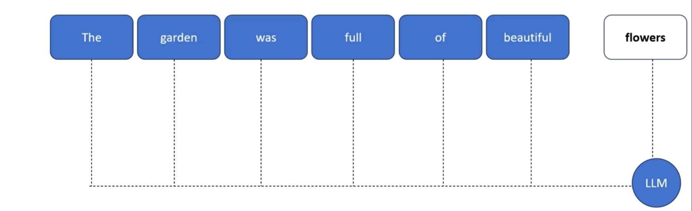
Large Language Models - LLMs
LLMs are based on transformer a type of Neural Network
LLM understands and generate text in a human like fashion

Slide 12

Large Language Models - LLMs
LLM
Prompt
Response

Slide 13

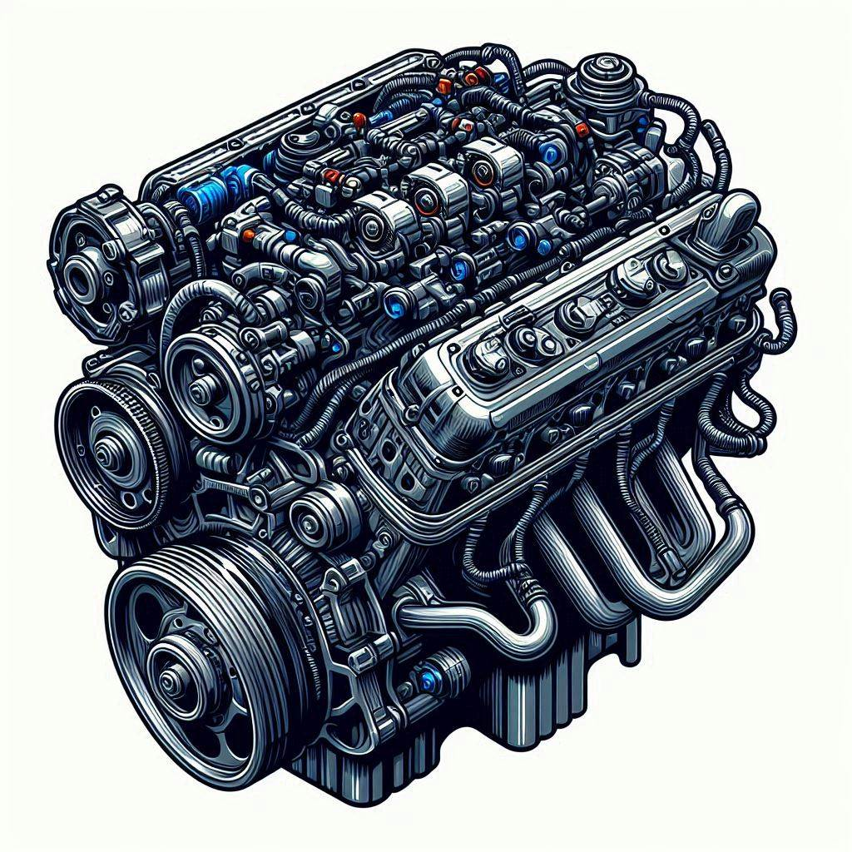
LLMs: GPT vs ChatGPT
GPT -> engine ChatGPT ->car

Slide 14
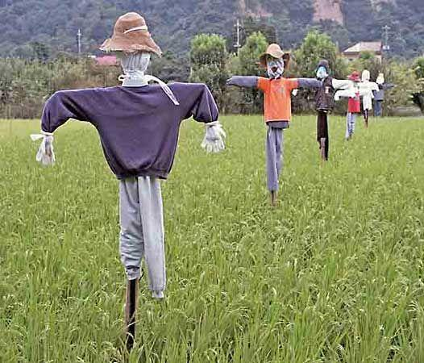

Prompts - Language of LLMs

Slide 15
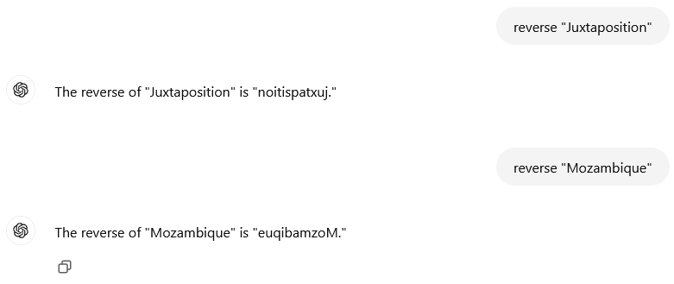
Prompts - Language of LLMs

Slide 16
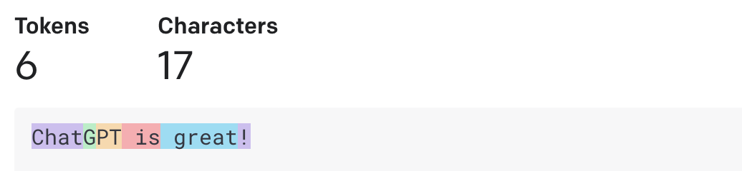
Tokenization

Slide 17
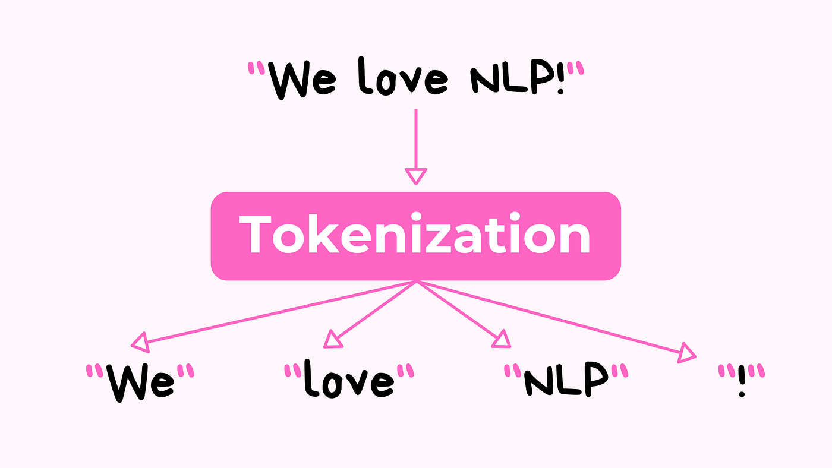
Tokenization
Process of dividing text into smaller units called tokens (individual words or sub-words) and assigning an ID to them
Prepares raw text for transformer models
<ID#> <ID#> <ID#> <ID#>

Slide 18
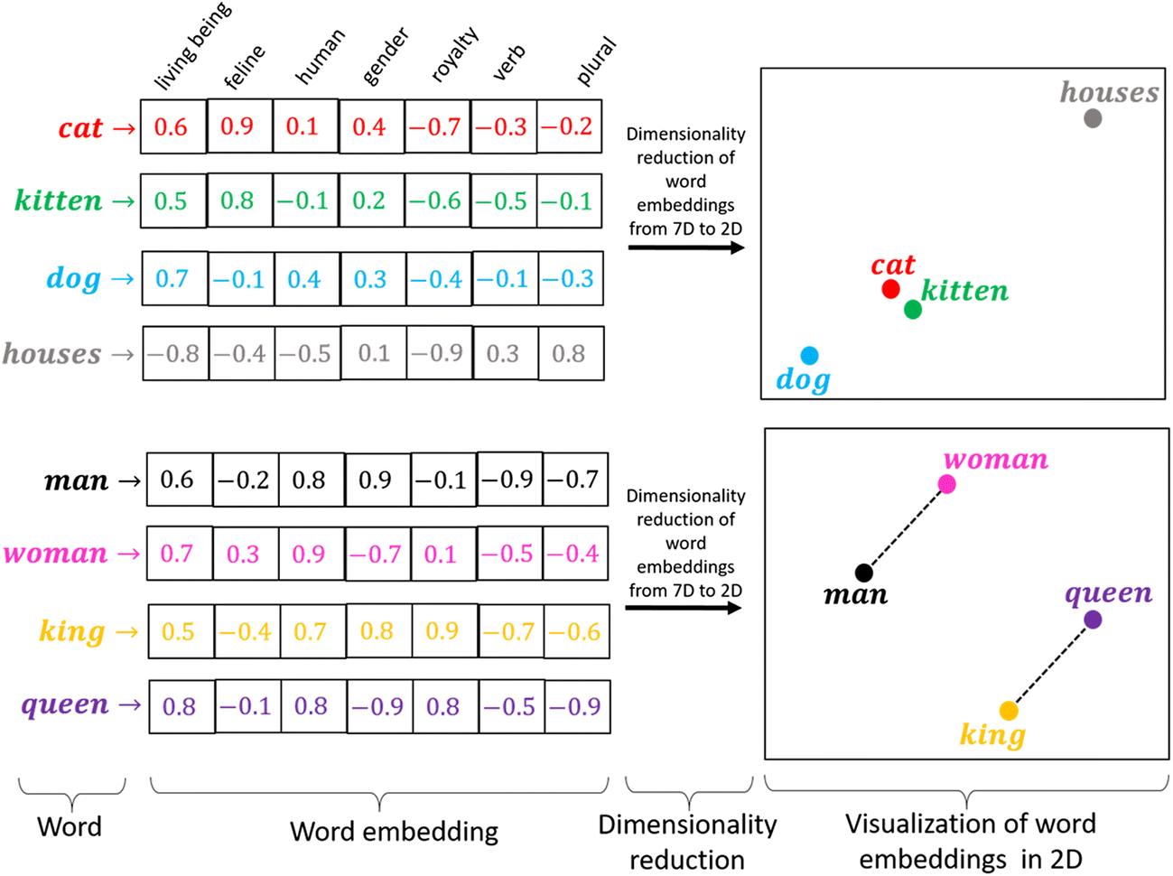
Embeddings
Represents tokens as vectors in a high dimensional space

Slide 19
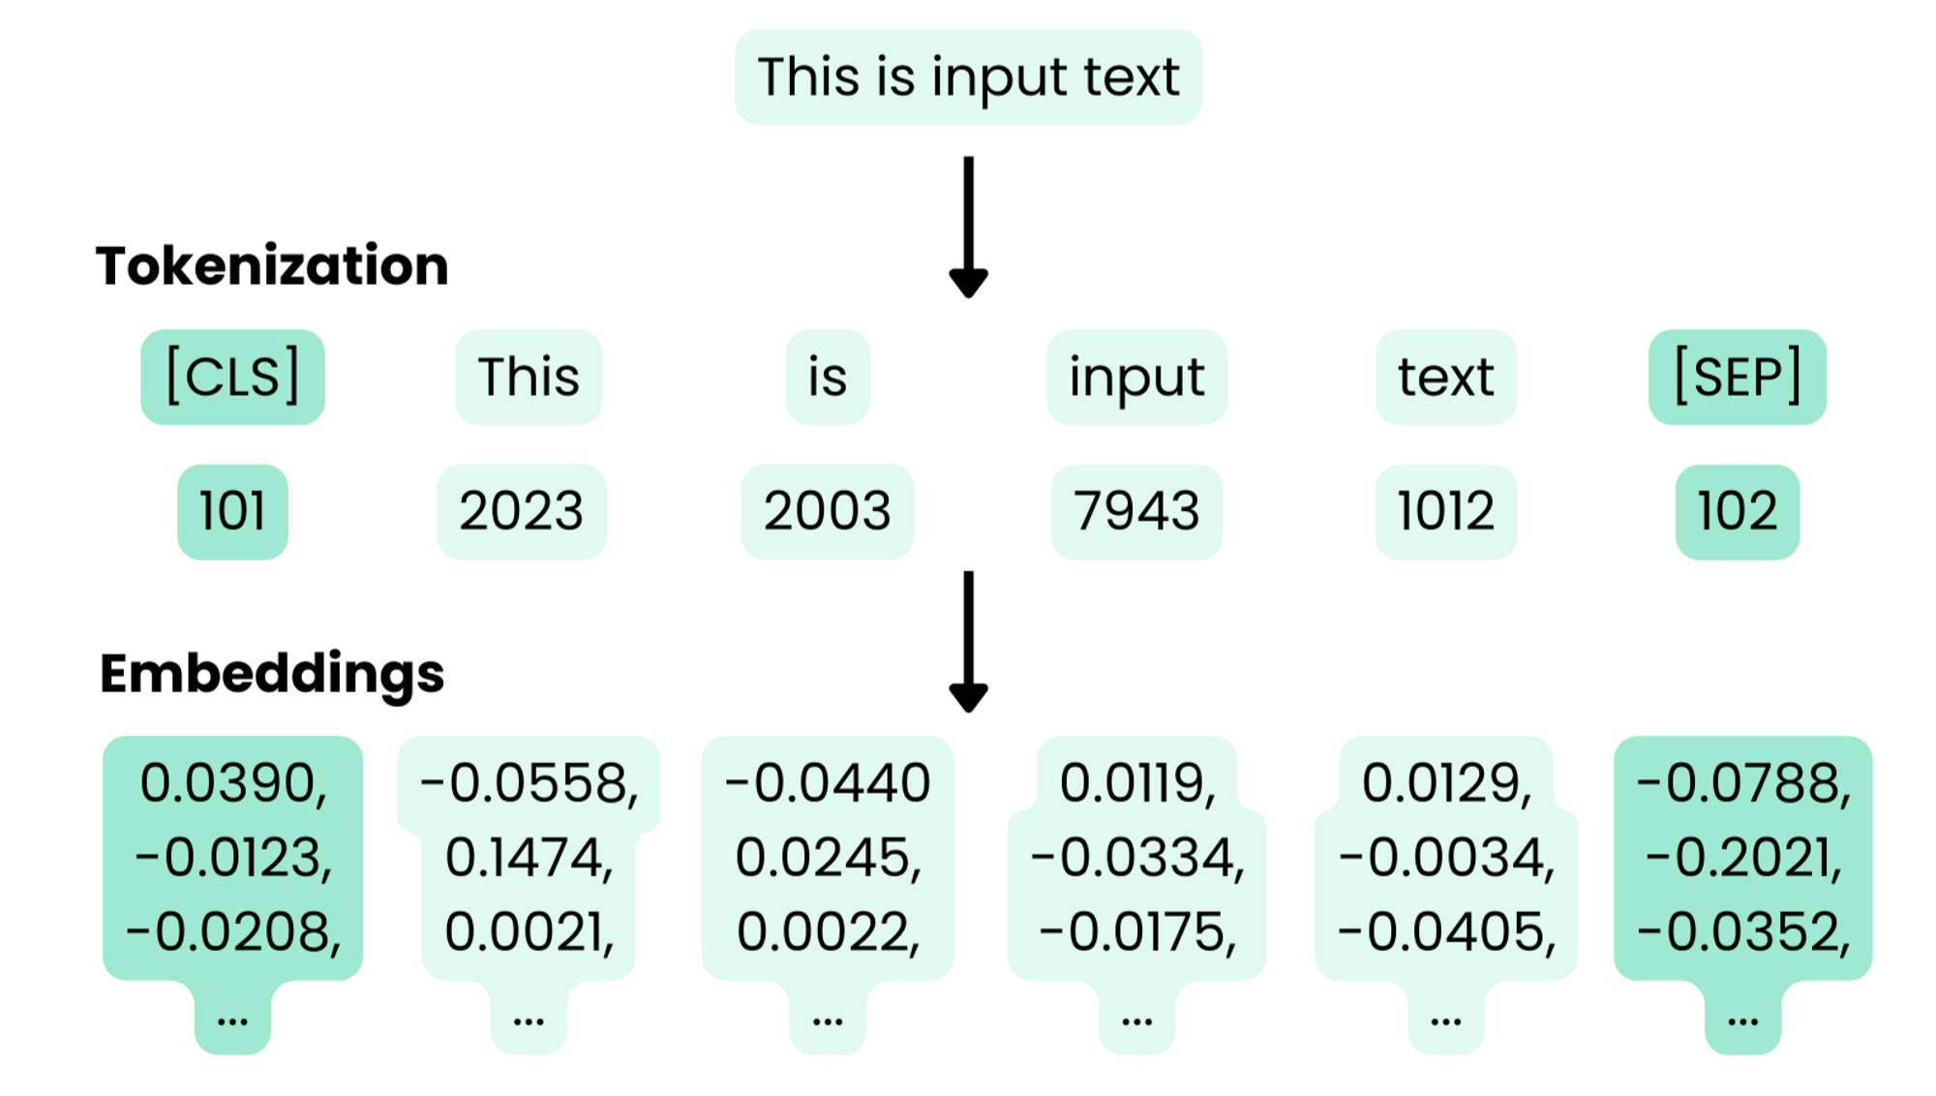
Preprocessing

Slide 20
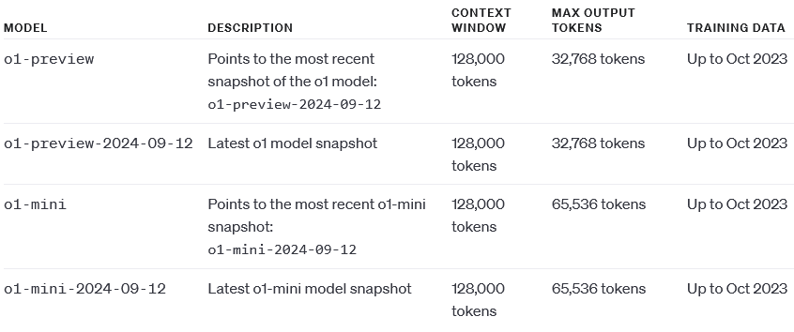
Context Token Limit
https://platform.openai.com/docs/models/o1

Slide 21
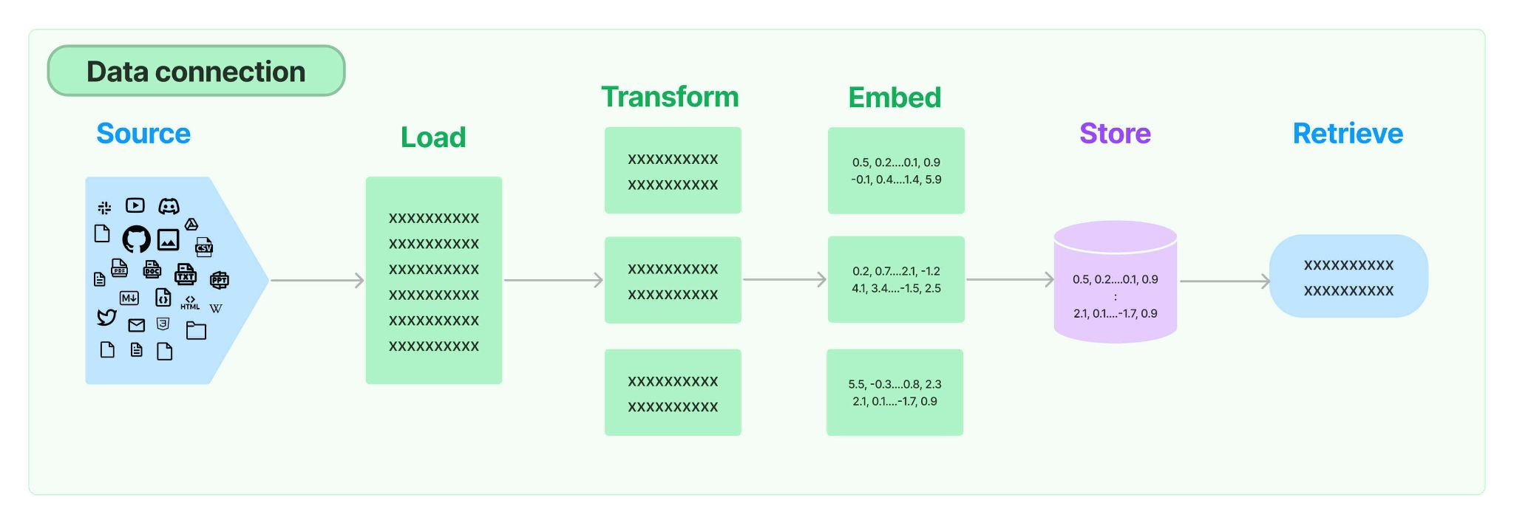
RAG - Data Connection
Bridge between the documents and the models

Slide 22
RAG - Load

Slide 23
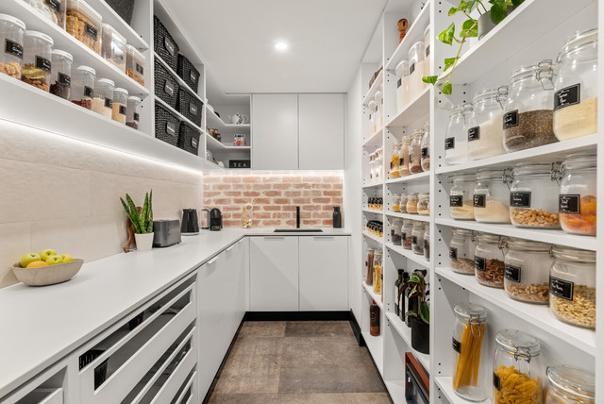
RAG - Load
Document Loader - Kitchen Pantry

Slide 24
RAG - Transform

Slide 25
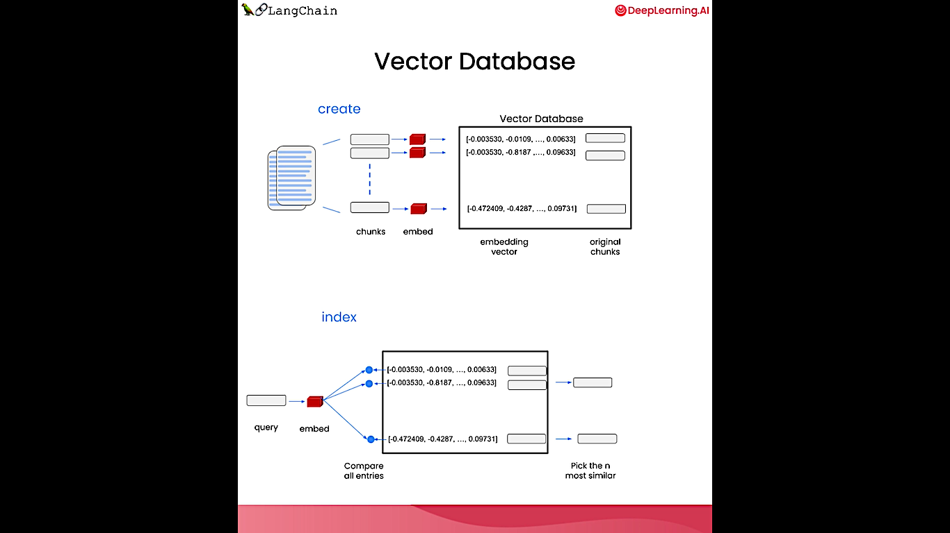
RAG - Transform
Transform documents into chunks

Slide 26

RAG - Transform
Transform utilities - Kitchen Equipments

Slide 27
RAG - Embed

Slide 28
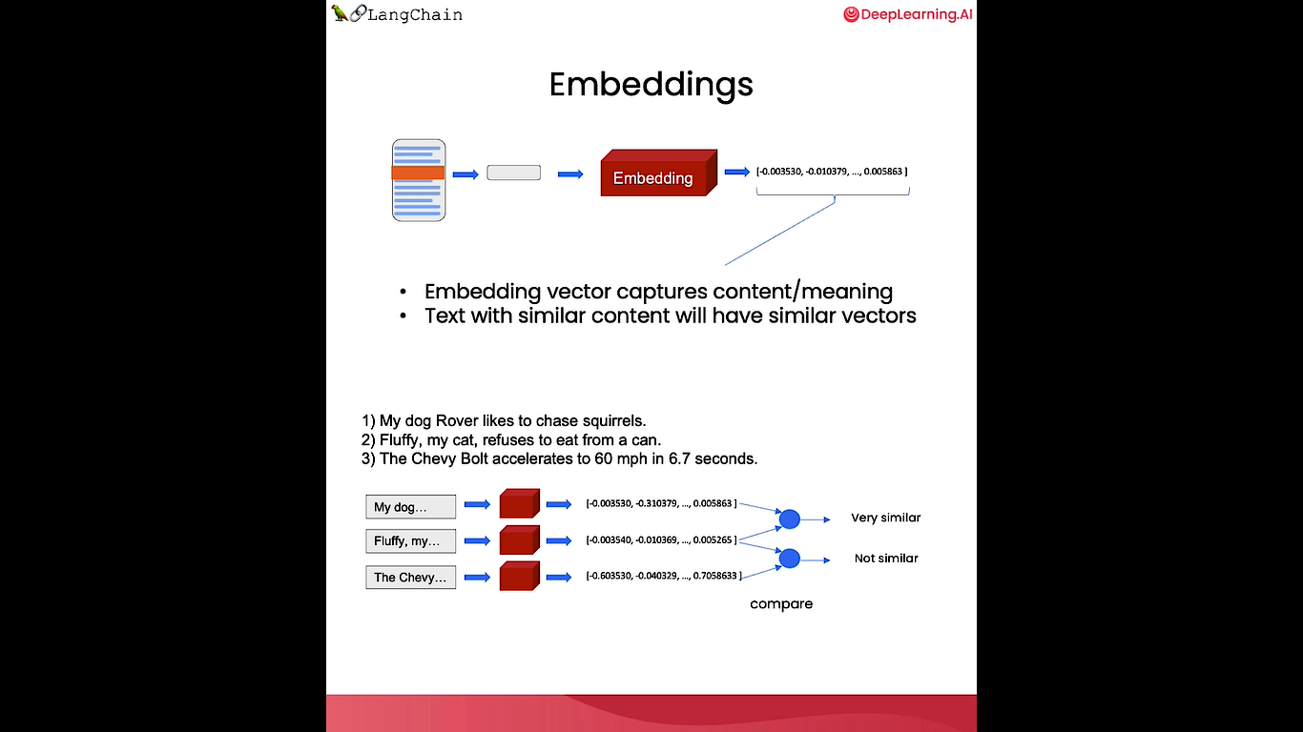
RAG - Embed
Embedding vector captures content/ meaning
Text with similar content will have similar vectors

Slide 29
RAG - Embed
My dog Rover likes to chase squirrels.
Fluffy, my cat, refuses to eat from a can.
The Chevy Bolt accelerates to 60 mph in 6.7 seconds.

Slide 30
RAG - Embed
Embedding models - Recipe books

Slide 31
RAG - Store

Slide 32
RAG - Store

Slide 33
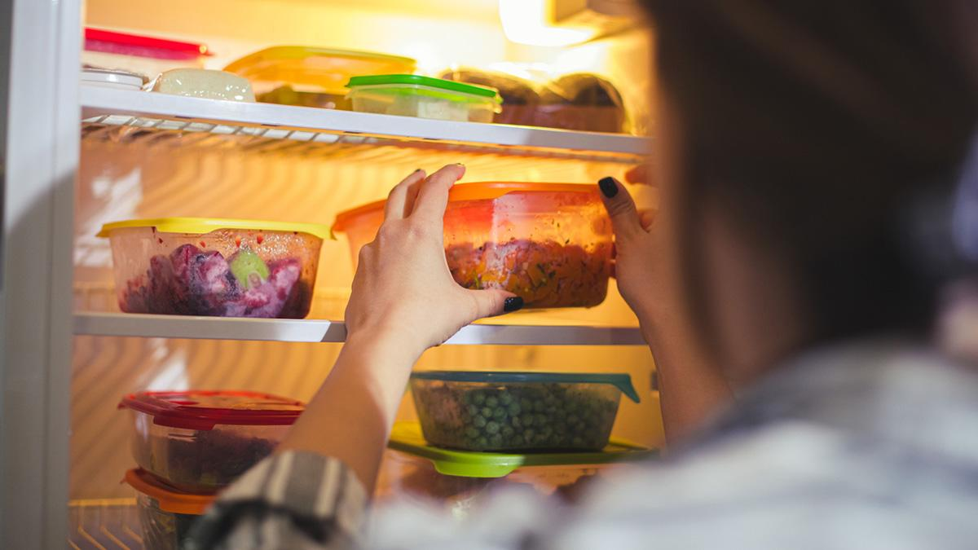
RAG - Store
Vector database - Refrigerator

Slide 34
RAG - Retrieve

Slide 35
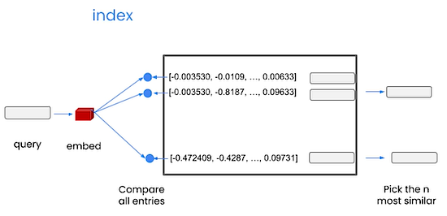
RAG - Retrieve
Retriever

Slide 36
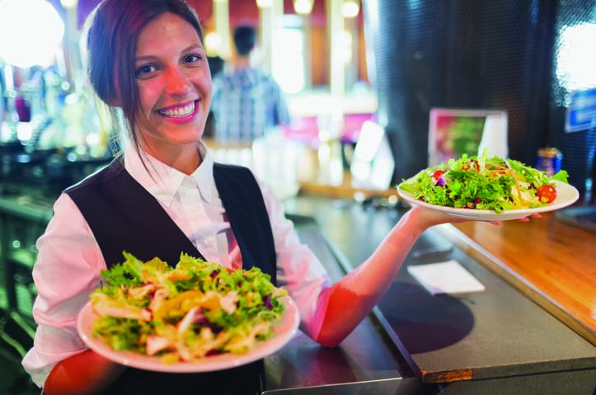
RAG - Retrieve
Retriever - Food Server

Slide 37
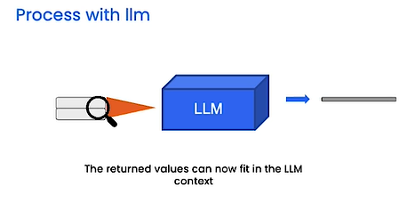
RAG in Action

Slide 38
Demo
https://github.com/arishp/nit-patna-genai-2025

Slide 39

Data Analytics for Manufacturing
– Arish P

Slide 40
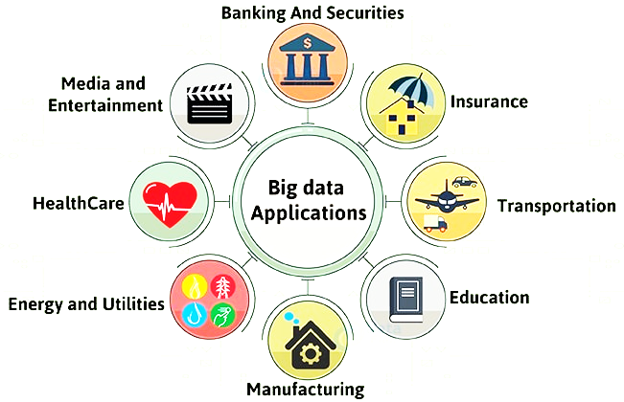
Analytics?
the systematic computational analysis of data

Slide 41
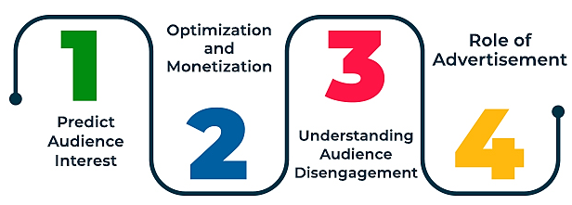
Media & Entertaiment

Slide 42
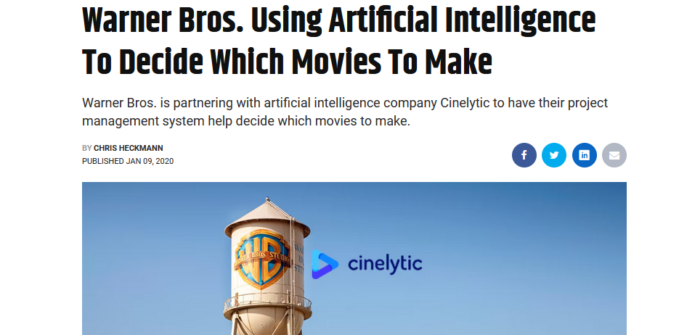
Media & Entertaiment

Slide 43
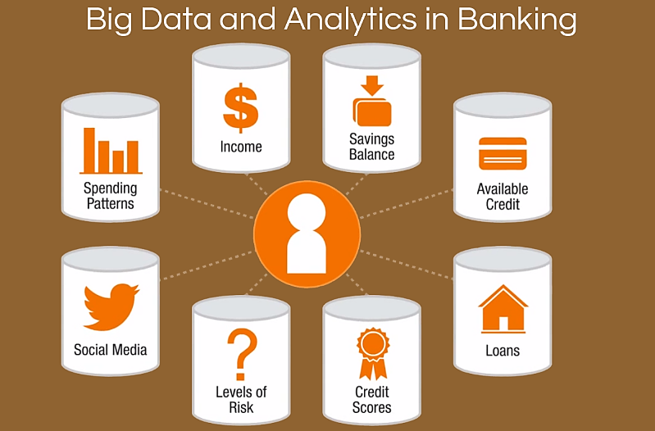
Banking & Securities

Slide 44
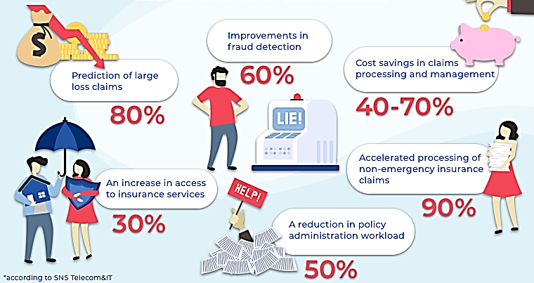
Insurance

Slide 45
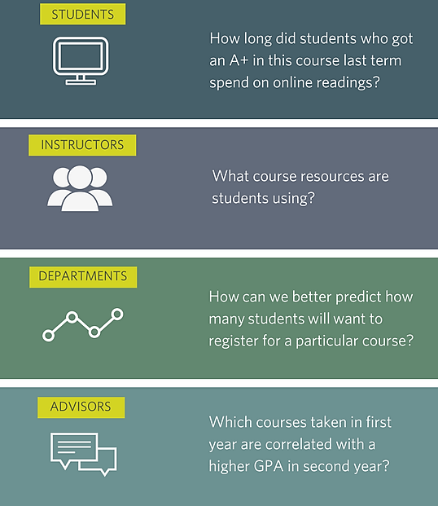
Education

Slide 46
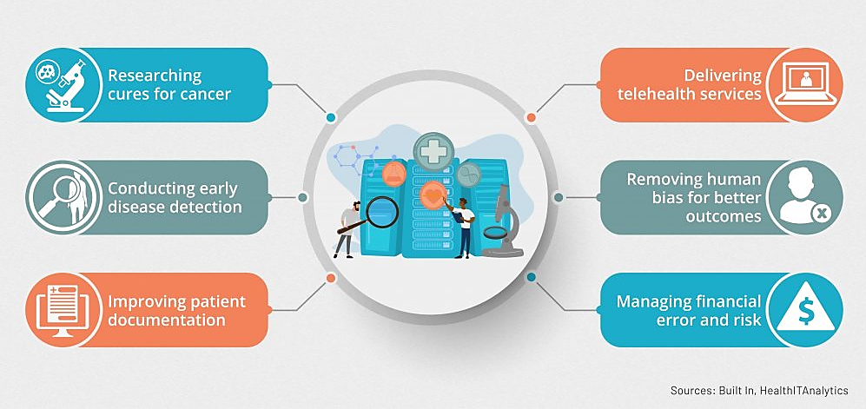
Healthcare

Slide 47
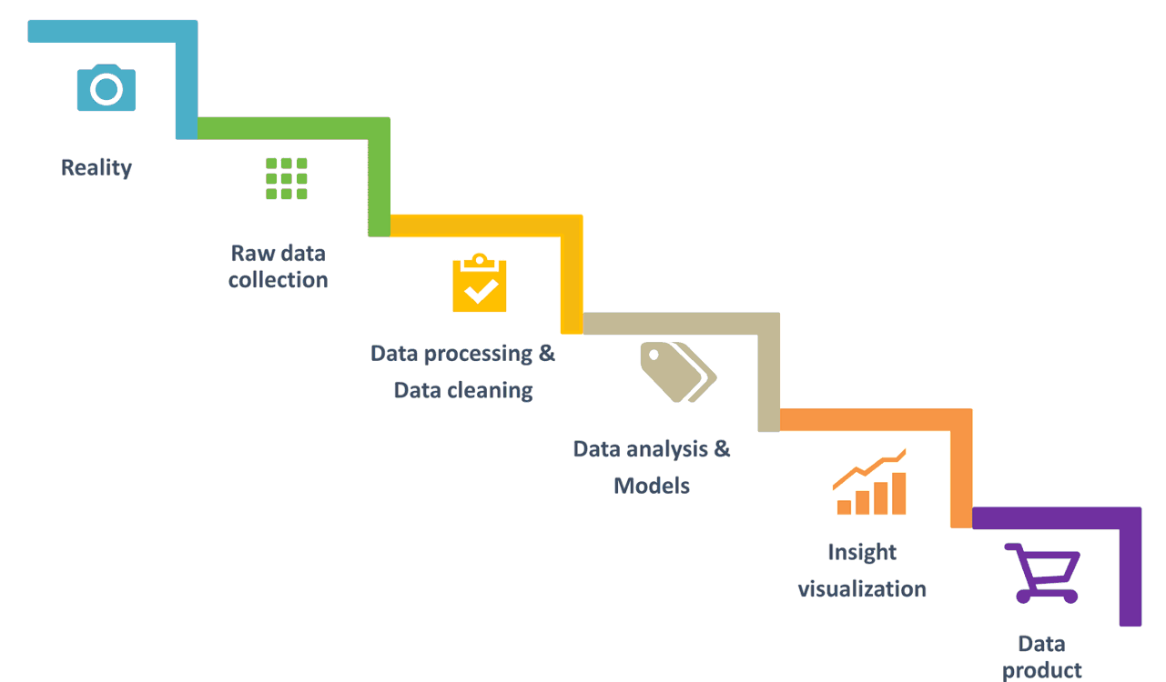
Phases of DA Process

Slide 48
Raw Data Collection
KNOWINGLY | UNKNOWINGLY
Customer forms | Transaction records
Loyalty Programs | Cookies
Surveys | Website visits
Service Agreements | Social media
Competitions | Keyword trackers

Slide 49
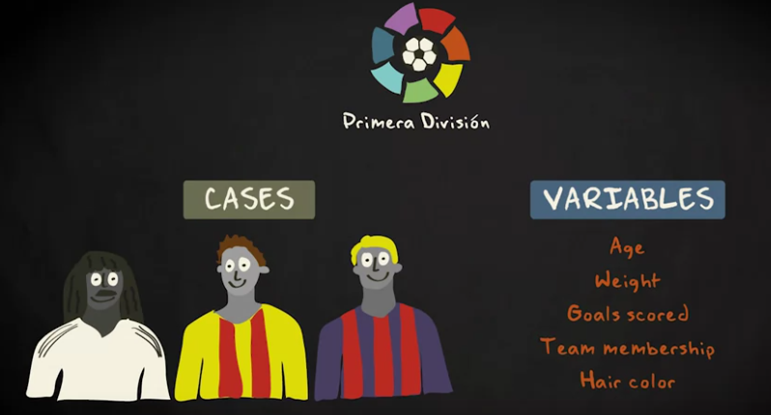
Data Representation

Slide 50
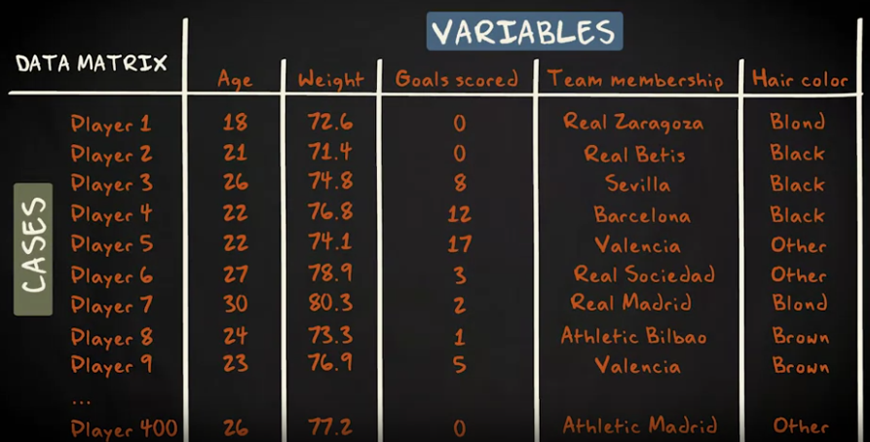
Data Frames

Slide 51
Data Pre-processing
Real application data usually contain errors and noise
Data without pre-processing: cause incorrect data analysis results

Slide 52
Errors / Outliers
Individual data with large deviations from normal
Eg of outliers:
Individual measurement error
Packet losses in data transmission
Storing data in wrong field
Typos, especially wrong position of decimal point

Slide 53
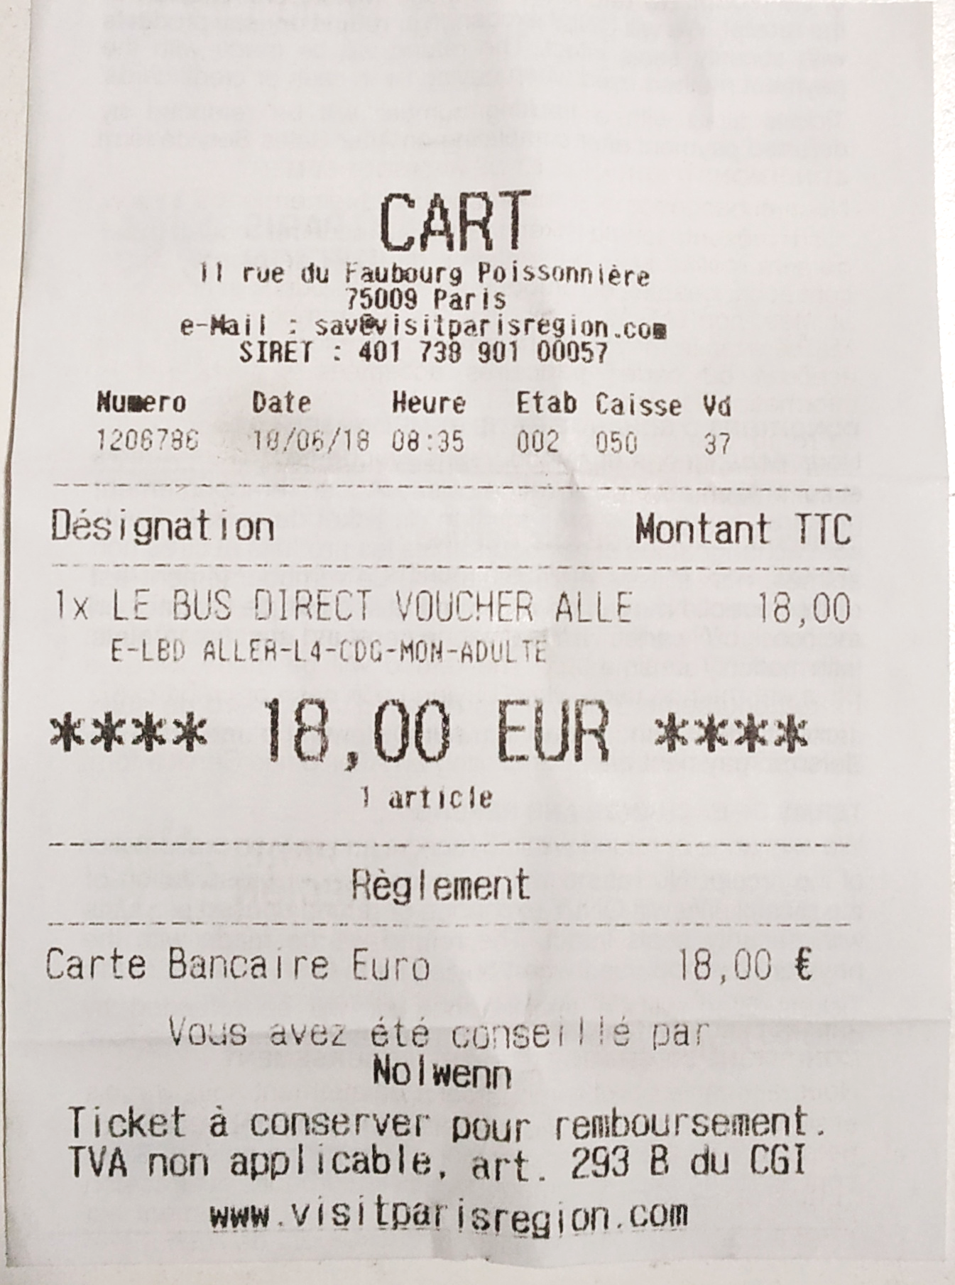
Errors / Outliers
Eg of outliers:
Data exchanged between systems using different meanings:
18 Euros → 1800 Euros
use of wrong formulas for the computation of derived data
measurement errors caused by wrong calibration, wrong scaling, or sensor drift

Slide 54
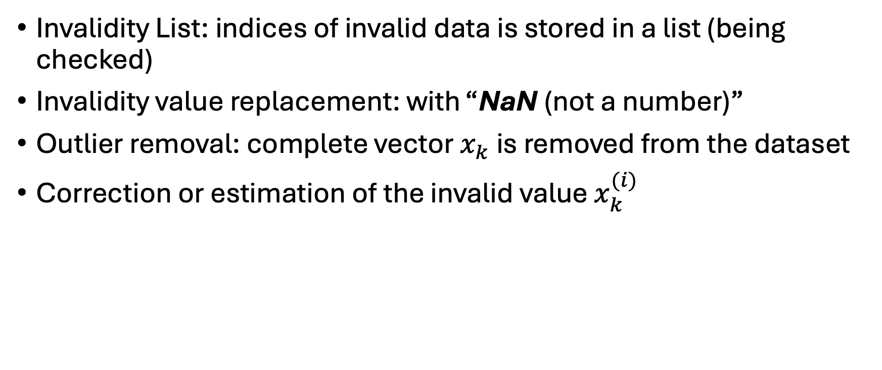
Error handling
Invalidity List: indices of invalid data is stored in a list (being checked)
Invalidity value replacement: with “NaN (not a number)”
Outlier removal: complete vector $x_{k}$ is removed from the dataset
Correction or estimation of the invalid value $x_{k}^{(i)}$

Slide 55
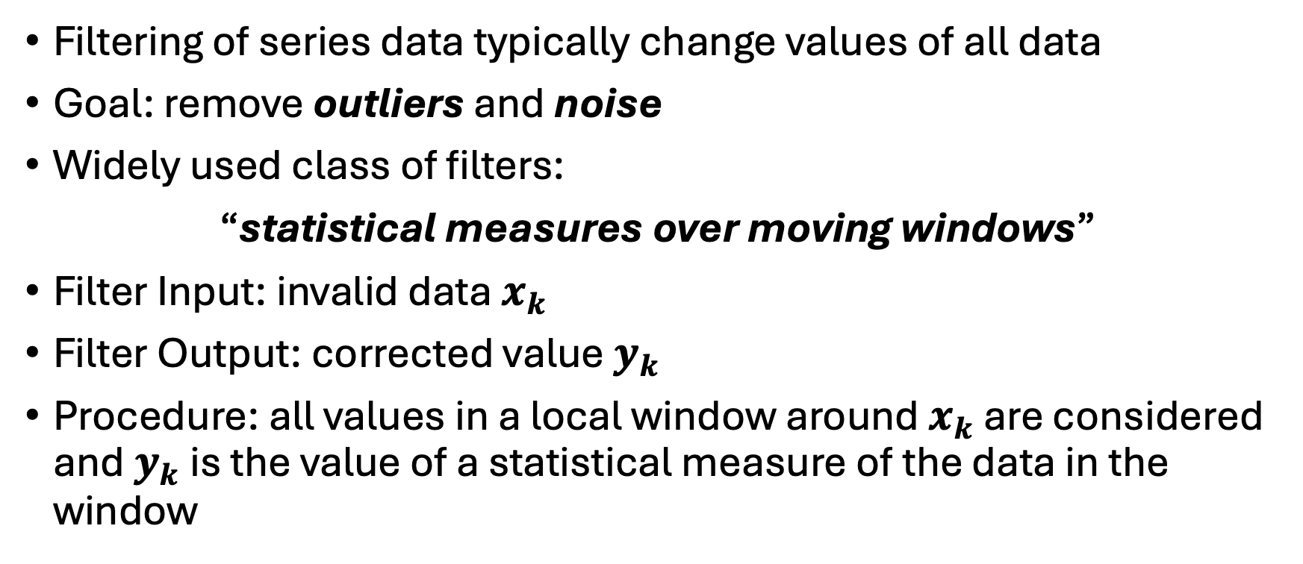
Filtering
Filtering of series data typically change values of all data
Goal: remove outliers and noise
Widely used class of filters:
“statistical measures over moving windows”
Filter Input: invalid data $x_{k}$
Filter Output: corrected value $y_{k}$
Procedure: all values in a local window around $x_{k}$ are considered and $y_{k}$ is the value of a statistical measure of the data in the window

Slide 56
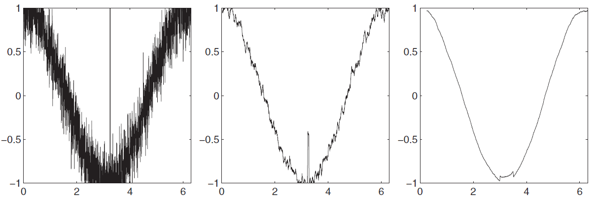
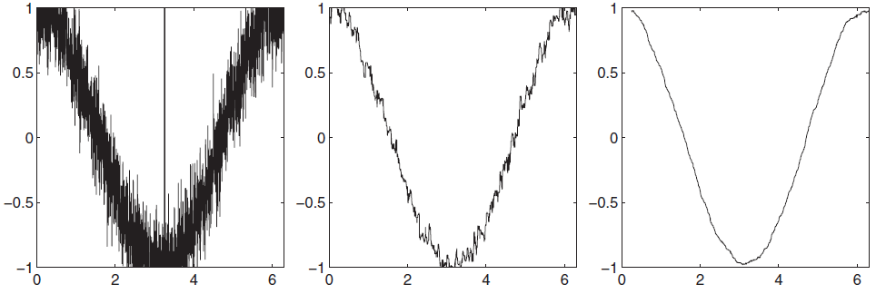
Mean Vs Median Filter on noisy data
Mean (q=21 & 201)
Median (q=21 & 201)

Slide 57
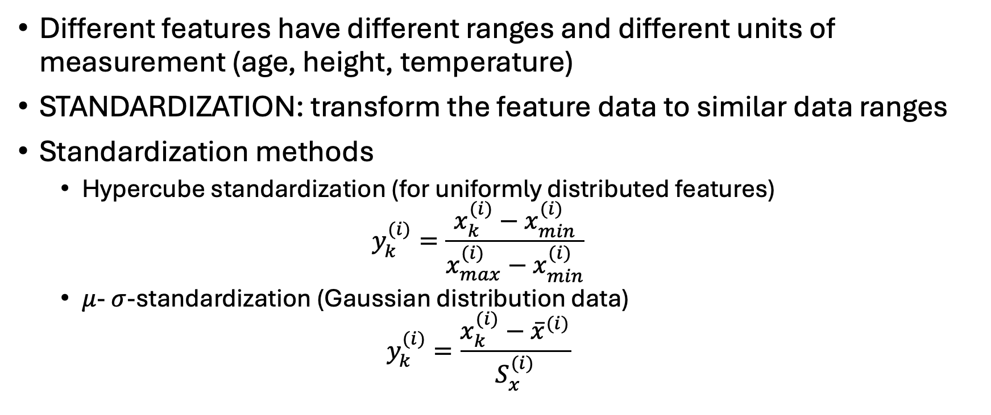
Data Transformation
Different features have different ranges and different units of measurement (age, height, temperature)
STANDARDIZATION: transform the feature data to similar data ranges
Standardization methods
Hypercube standardization (for uniformly distributed features)
$$y_{k}^{(i)}=\frac{x_{k}^{(i)}−x_{min}^{(i)}}{x_{max}^{(i)}−x_{min}^{(i)}}$$
$μ$- $σ$-standardization (Gaussian distribution data)
$$y_{k}^{(i)}=\frac{x_{k}^{(i)}−{\overline{x}}^{(i)}}{S_{x}^{(i)}}$$

Slide 58
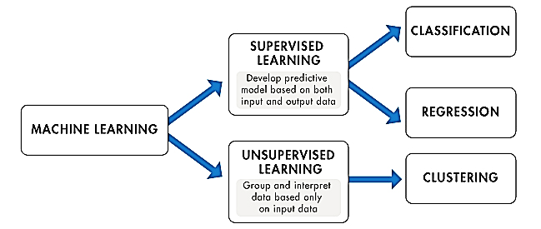
Glimpse of Analytics

Slide 59
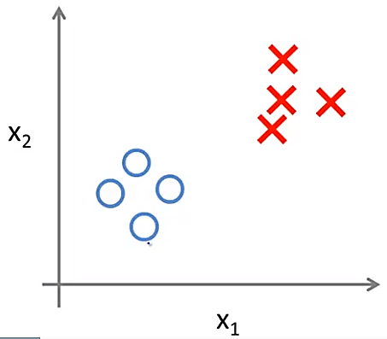
Supervised Learning

Slide 60
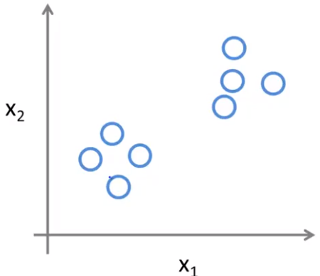
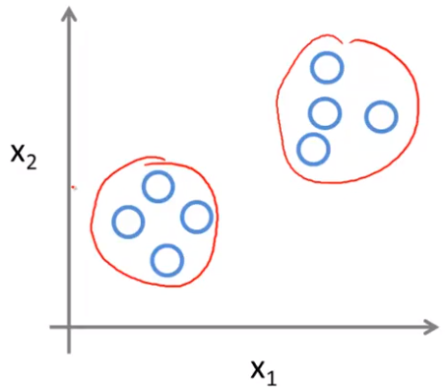
Unsupervised Learning
Clustering

Slide 61
Classification
Comes under supervised learning
Considers data of objects that are assigned to n classes
Types of classifiers:
Naïve Bayes
Linear Discriminant Analysis
Support Vector Machine
Nearest Neighbor
Learning Vector Quantization
Decision Trees

Slide 62
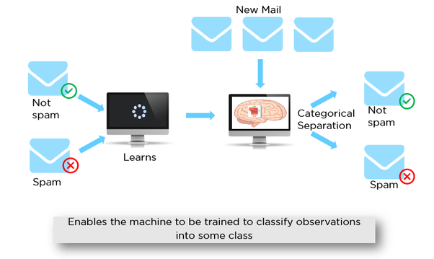
Classification: Supervised Learning

Slide 63
Classification
Labelled feature data set: tuples of feature data and class assignment
Classifier design: process of constructing a classifier
Classifier function: Takes un-labelled feature data set as input and yields a class as output
Training set: part of the dataset used to train the model
Testing set: part of the dataset used to evaluate the model

Slide 64
Decision Tree Classifier
Decision based on hierarchical examination
Eg: Medical diagnosis
Initial examination: Temperature, BP and Weight is taken first
Next level: Blood, urine, etc tests
Information gain yielded in each step

Slide 65
Decision Tree example
1 BHK or smaller
1 BHK or smaller
YES
NO
YES
NO
Rent: 10K
Rent: 14K
Rent: 14K
Rent: 12K

Slide 66
Decision Tree example
1 BHK or smaller
YES
NO
Metro city
YES
YES
NO
NO
Furnished
YES
NO
14K
10K

Slide 67


Slide 68
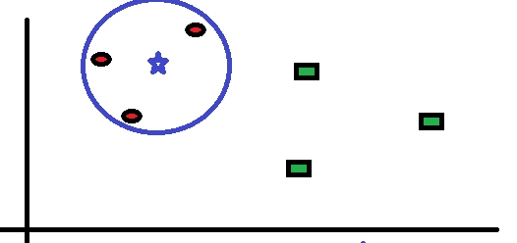
Nearest Neighbour Classifier (k-NN) k=3

Slide 69
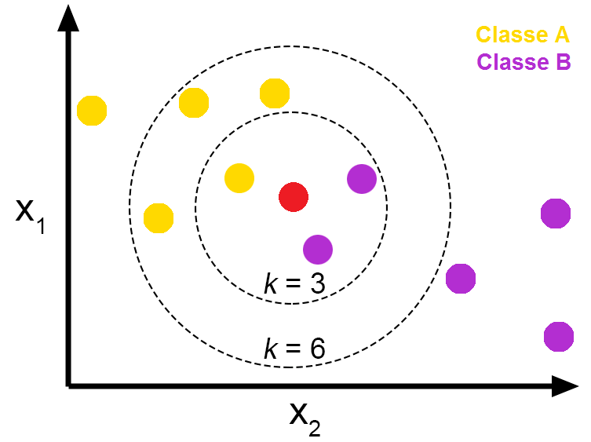
Nearest Neighbour Classifier (k-NN)

Slide 70
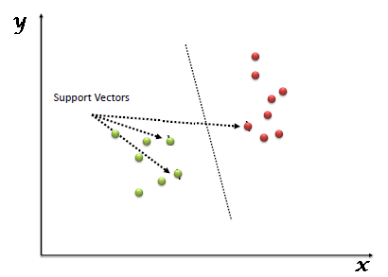
SVM: 2D Hyperplane

Slide 71
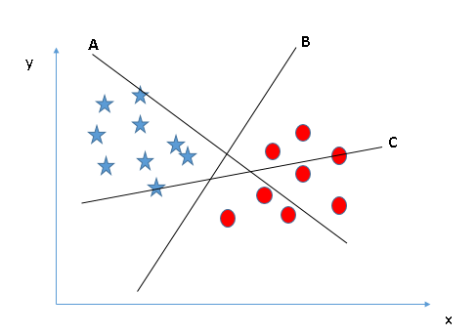
SVM: Pick the right hyperplane

Slide 72
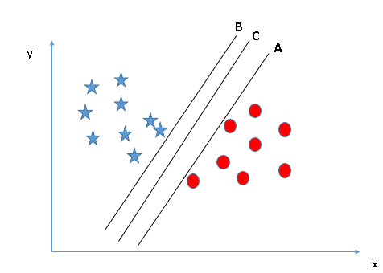
SVM: Pick the right hyperplane

Slide 73
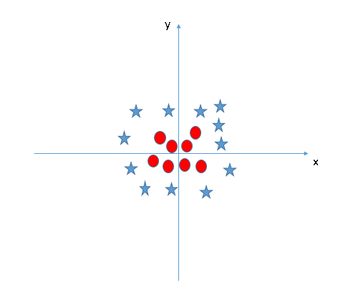


SVM: Pick the right hyperplane
$$z=x^{2}+y^{2}$$

Slide 74
Classifier Result
Eg: Ideal classifier classifies all ‘sick’ patients as ‘sick’ and all healthy patients as ‘healthy’
Four types of classifications
TP: True positive (‘sick’ patient classified as ‘sick’)
TN: True negative (‘healthy’ patient classified as ‘healthy’)
FP: False positive (‘healthy’ patient classified as ‘sick’) – Type 1 error
FN: False negative (‘sick’ patient classified as ‘healthy’) – Type 2 error

Slide 75

Evaluation Metrics: Cross Validation
Validate statistical models generated from data
It is done to avoid overfitting
Partition the available input-output data set a training data set ($Z_{t}$) and a disjoint validation data set ($Z_{v}$)
Training data are used to build (train) a model, and the validation data are used to validate this trained model

Slide 76
Classification: Training & Testing
Labelled
Dataset
Training set
Learning Algorithm
Prediction Model
Validation set
Model Evaluation

Slide 78
Regression Model
In correlation, the two variables are treated as equal
In regression, one variable is considered independent (=predictor) variable (X) and the other the dependent (=outcome) variable Y
Used Mainly for Prediction & Estimation

Slide 79


Slide 80

Types of regression models

Slide 81
What is “Linear”?
Linear regression assumes that the relationship between X and Y is linear
Uses equation of a line to set up relationship
Y=mX + C?
If you know something about X,
you predict something about Y
Y axis
m
C
X axis

Slide 82
Estimating parameters
Parameters in equation: Y=mX + C
m – slope
c – intercept

Slide 83


Slide 84
Scatter plot
Plot of All (X_{i}, Y_{i}) Pairs
Suggests How Well Model Will Fit
Y
60
40
20
0
X
0
20
40
60

Slide 85
Y
60
40
20
0
X
0
20
40
60
Notes:
42

Slide 86
Slope changed
Y
60
40
20
0
X
0
20
40
60
Intercept unchanged
Notes:
43

Slide 87
Slope unchanged
Y
60
40
20
0
X
0
20
40
60
Intercept changed
Notes:
44

Slide 88
Slope changed
Y
60
40
20
0
X
0
20
40
60
Intercept changed
Notes:
45

Slide 89
Least Squares Method (LS)
Best Fit: Difference Between Actual Y Values & Predicted Y Values Are a Minimum
Objective of LS: To minimize the “sum of squared differences (errors): SSE”

Slide 90
Least Squares Graphically
Notes:
52

Slide 92

Clustering
Eg: news.google.com

Slide 93

Clustering
Classification is done on labelled data
Clustering is done on unlabelled data
Clustering identifies structures in data
Clusters: often used as class estimators
Types of clustering:
Sequential clustering
Partitional clustering

Slide 94

Clustering Methods

Slide 95


Clustering: Python code
Scatter plot of 6 data points

Slide 96



Clustering Partitions
Cluster structure partitions X
Partitions are disjoint subsets
E.g.:
$C_{1}$ = {(2,2), (3,2), (4,3)}
$C_{2}$ = {(6,7), (7,8), (8,8)}
Crisp Partition:

Slide 97
Applications of Clustering
Business Intelligence: Grouping the customers
Image recognition: Handwriting patterns of numbers
Web search: Google news
Outlier detection: E-commerce (credit card fraud)

Slide 98
Types of Clustering
Sequential – SAHN
Partitioning – k means, k medoids
Hierarchical – agglomerative or divisive
Density based – based on density
Grid based – based on grid structure
Etc…

Slide 99


K-means: Centroid based Technique

Slide 100
Hierarchical Clustering (Agglomerative)
“grow” clusters from the bottom up
Procedure:
1. Make each input its own cluster of one
2. As long as there are multiple clusters remaining, find the two closest clusters and merge them
End product: one giant cluster containing all the inputs
Any number of clusters can be recreated by unmerging

Slide 101

Hierarchical Clustering (Agglomerative)

Slide 102

Hierarchical Clustering (Agglomerative)

Slide 103

Hierarchical Clustering (Agglomerative)

Slide 104

Hierarchical Clustering (Agglomerative)

Slide 105

Hierarchical Clustering (Agglomerative)

Slide 106

Hierarchical Clustering (Agglomerative)

Slide 107

Hierarchical Clustering (Agglomerative)

Slide 108
Hierarchical Clustering (Divisive)
“grow” clusters from the top to down
Conceptually more complex than bottom-up clustering
There is need for a second, flat clustering algorithm as a “subroutine”

Slide 109

Hierarchical Clustering (Divisive)

Slide 110
Cluster Validity
Used to estimate the number of clusters contained in the data
Clustering is performed for different numbers of clusters
The resulting partition with the best validity indicates the appropriate number of clusters
Frequently used cluster validity measures:
Avg. square membership/ Partition coefficient
Avg. entropy/ Classification entropy

Slide 111
Data Visualization
The human eye (and brain) is a very powerful tool for analyzing data
Visualized data are also useful for documenting and communicating data analysis results
2-D visualization: Papers and screens
3-D or more: Projection methods

Slide 112

Applications of ML in Manufacturing
Defect detection
Predictive maintenance
Energy consumption forecasting
Supply chain optimization
Digital twins
Generative designs
Intelligent document processing

Slide 113
Predictive Maintenance: Classification
https://www.kaggle.com/competitions/playground-series-s3e17/overview
https://www.kaggle.com/code/arishp/nit-predictive-maintenance-of-machine-failure

